Slide 2


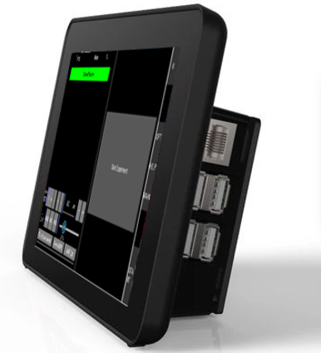
Internal
GLOBAL IP
connection through internet
External
In-Vivo,
T-cells, 18h
LED-Matrix (MQTT device)
WiFi connection
WiFi connection
WiFi connection
WiFi Router
Remote Control App
(MQTT Device)
Wired connection
Remote User
(MQTT Device)
Z-Stage
(MQTT device)
Incubator Microscope
Touch Screen Device
(Python, Kivy; wired to the Pi)
MQTT Broker, WiFi Router, Camera controler

Slide 3

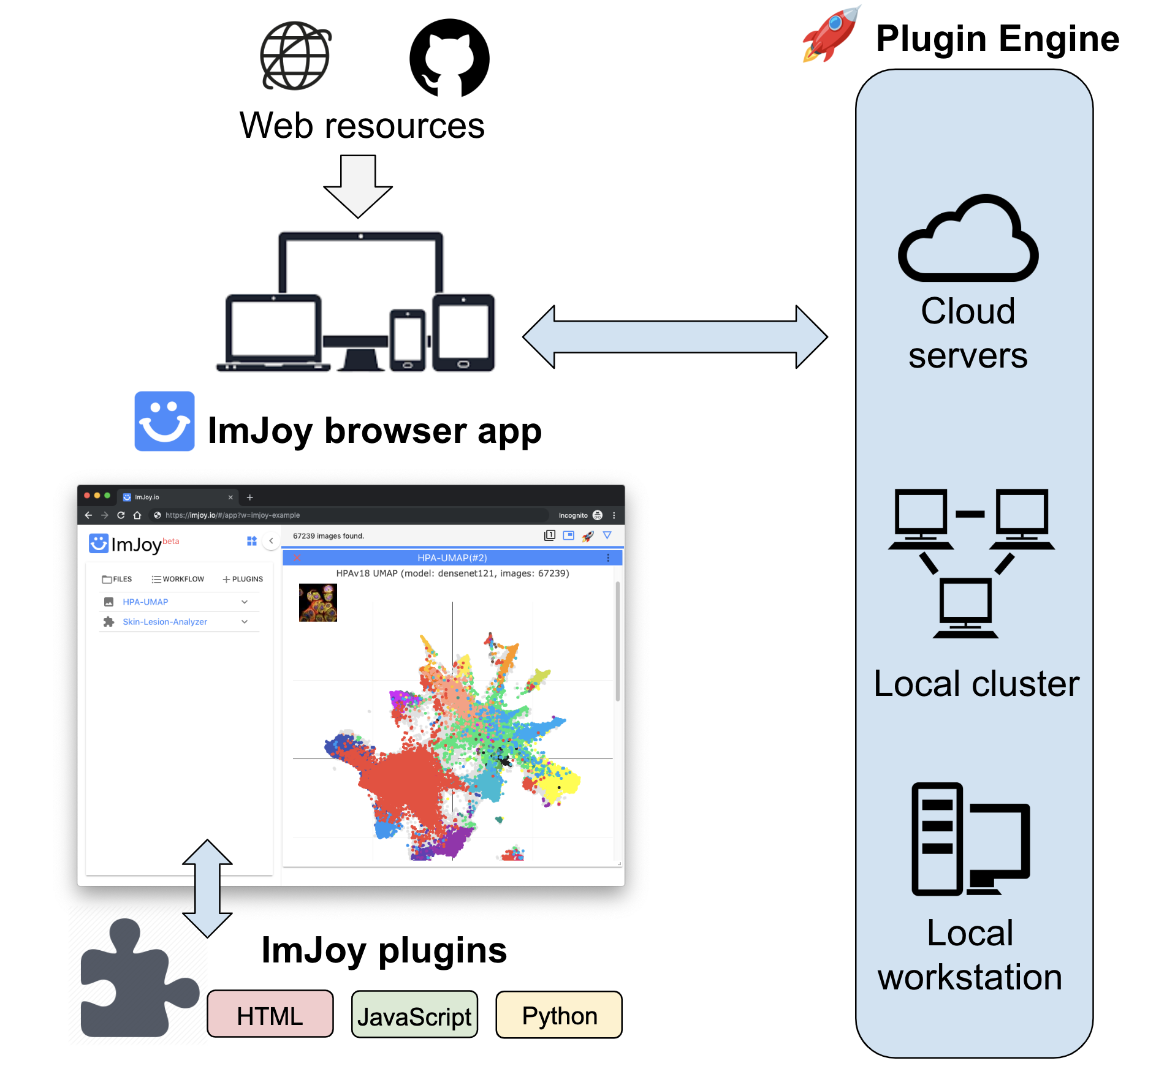

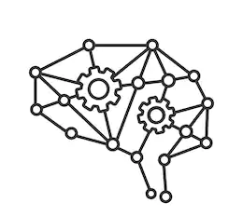
Wei Ouyang
Users
Deep Learning

Slide 4
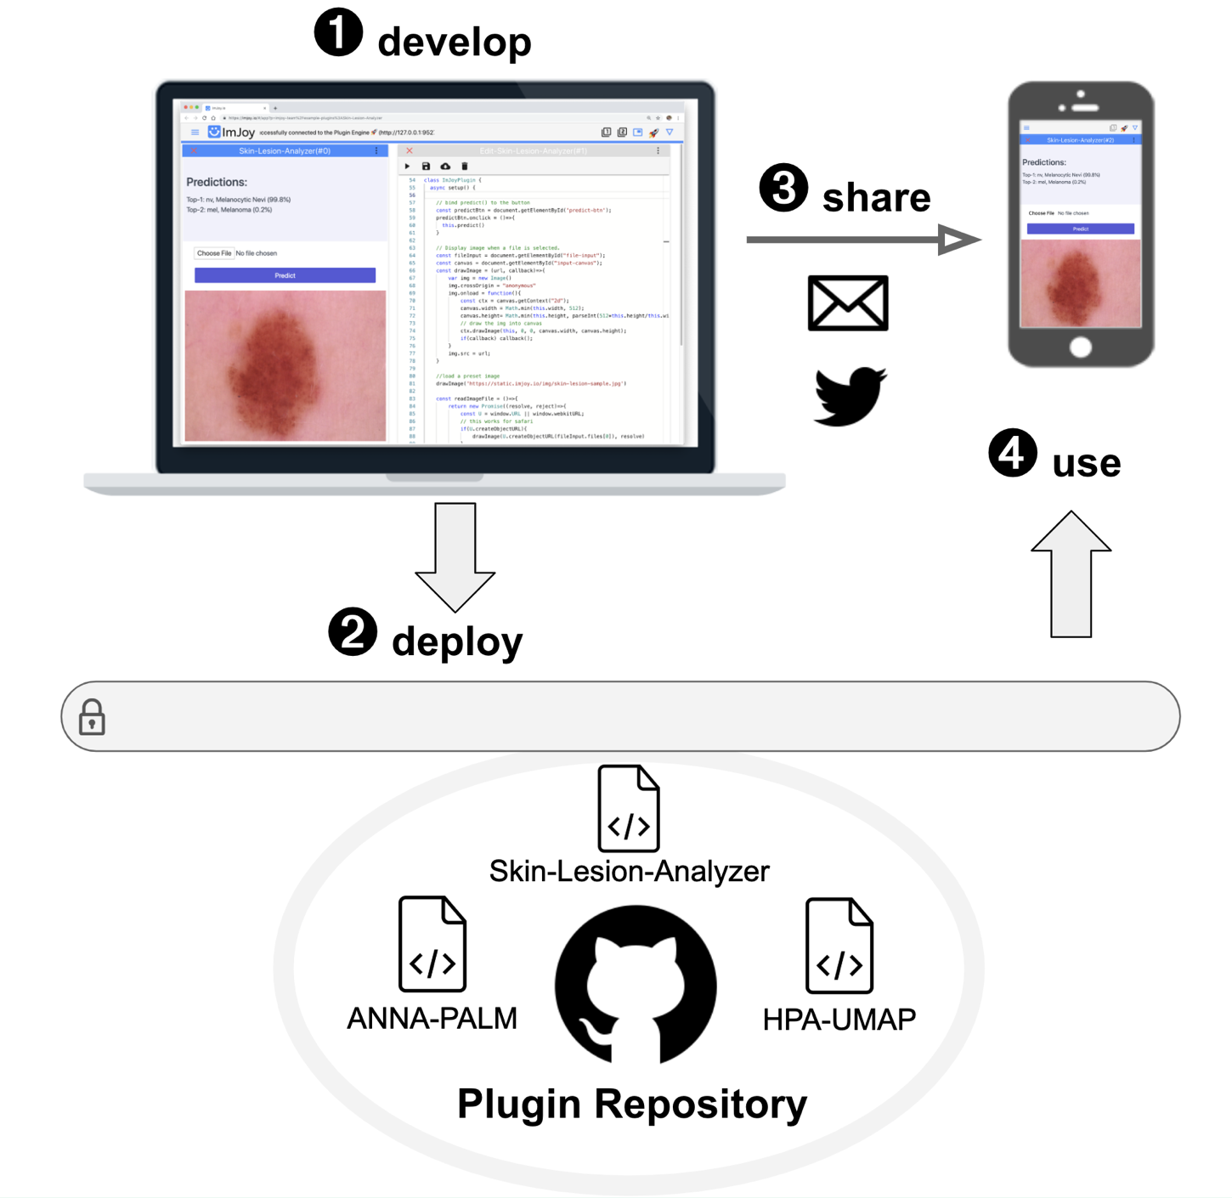
Easy sharing
Privacy aware
https://imjoy.io/#/app?p=imjoy-team/example-plugins:Skin-Lesion-Analyzer
Notes:
https://imjoy.io/#/app?w=imjoy-examples&plugin=imjoy-team/example-plugins:HPA-UMAP&start=HPA-UMAP&fullscreen=1

Slide 5


+
Optical Setup
Exp. Data
LAB
Control Signals
UC2
Multi-Modal Modular Microscope
Open
Lab-in-the-Cloud
Idea-Hub | Think-Tank | Project Junction
User Request
ImJoy, ML/AI
Hardware-Control, Image Analysis
Exp. Data
Control Signals
Sample
FluidiC
Reproducible biological setups
Control Signals
Processed Data/Results
Bio exp. setup
Result
Exp. Request
New Ideas
User
User
Notes:
https://imjoy.io/#/app?w=imjoy-examples&plugin=imjoy-team/example-plugins:HPA-UMAP&start=HPA-UMAP&fullscreen=1

